Slide 1
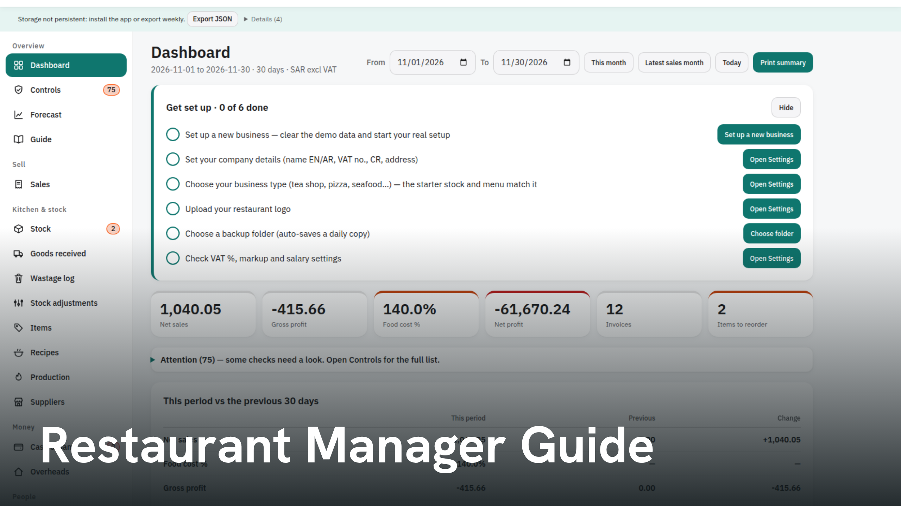
Notes:
Restaurant Manager Guide

Slide 2
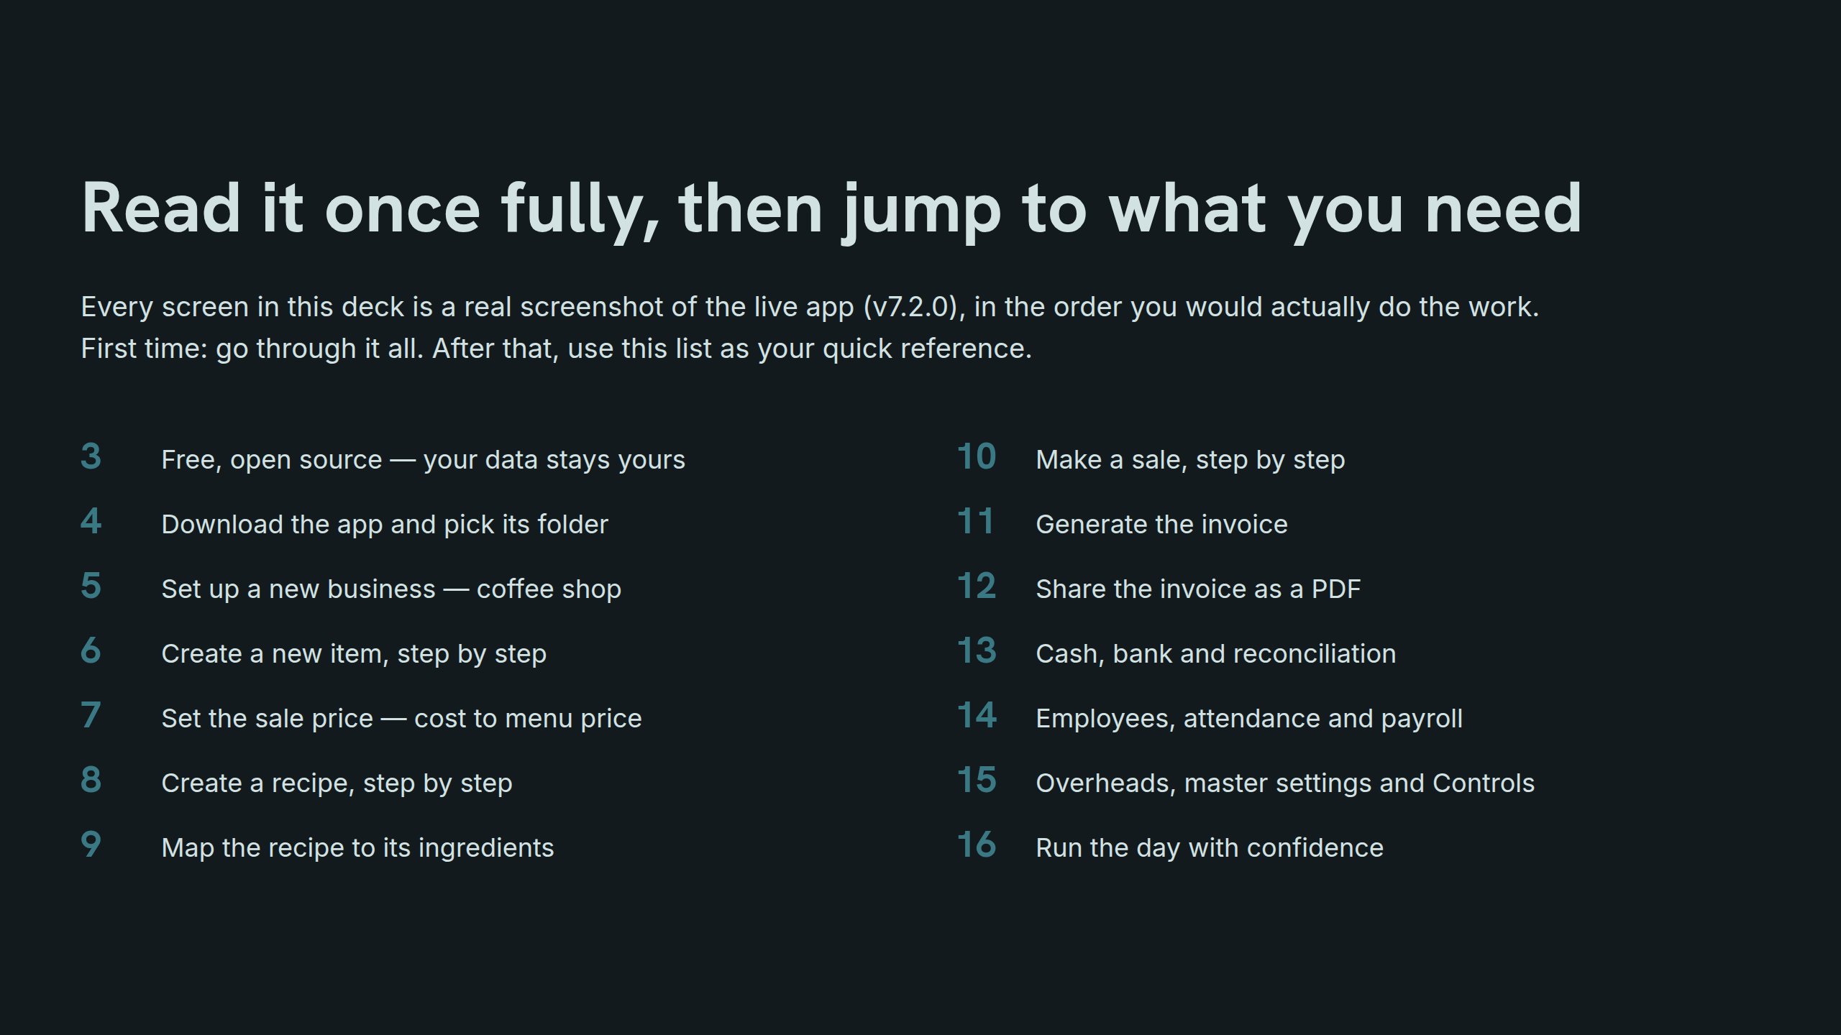
Notes:
Read it once fully, then jump to what you need

Slide 3
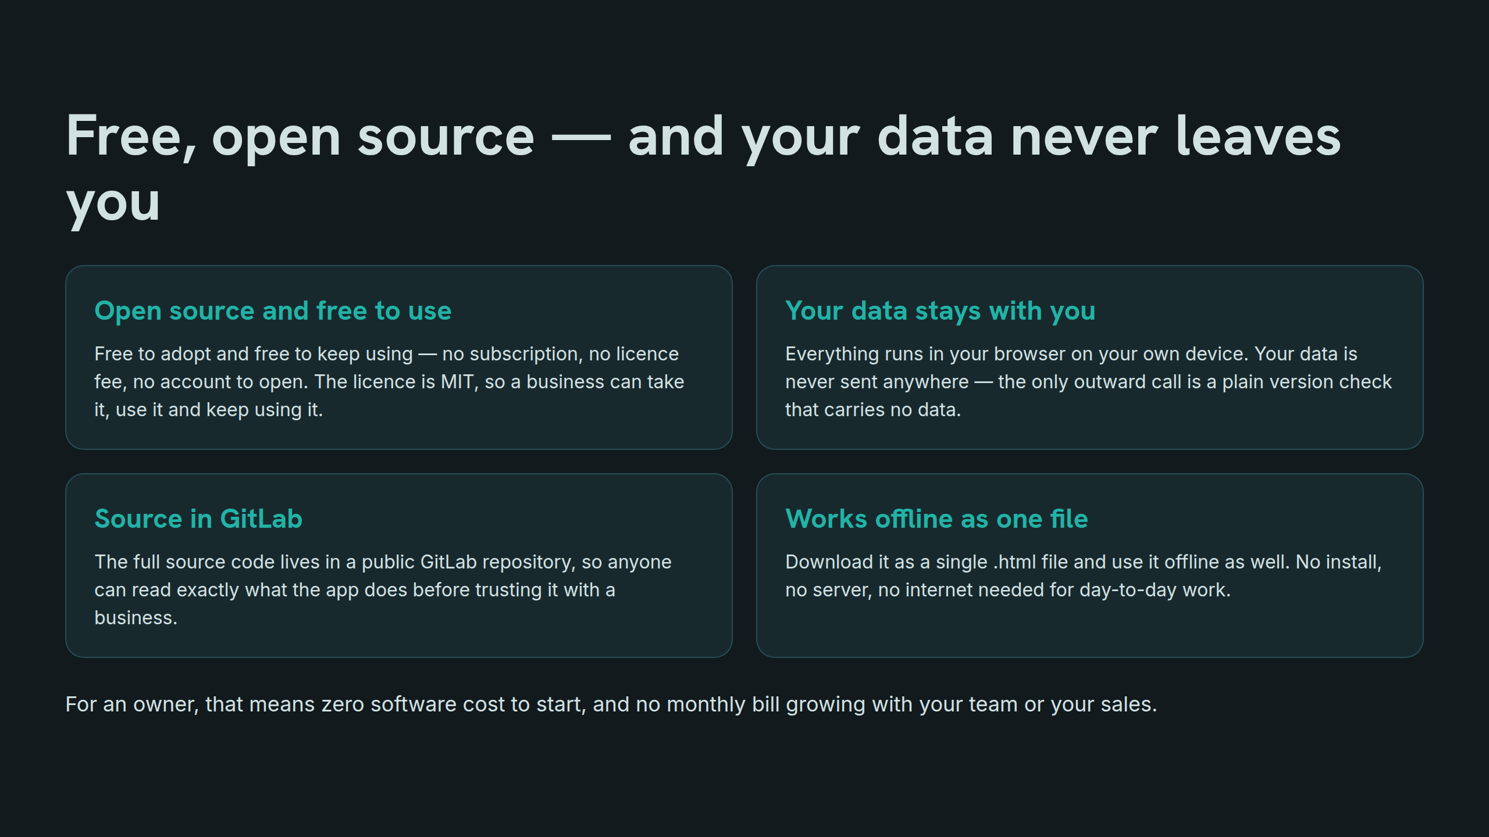
Notes:
Free, open source — and your data never leaves you

Slide 4
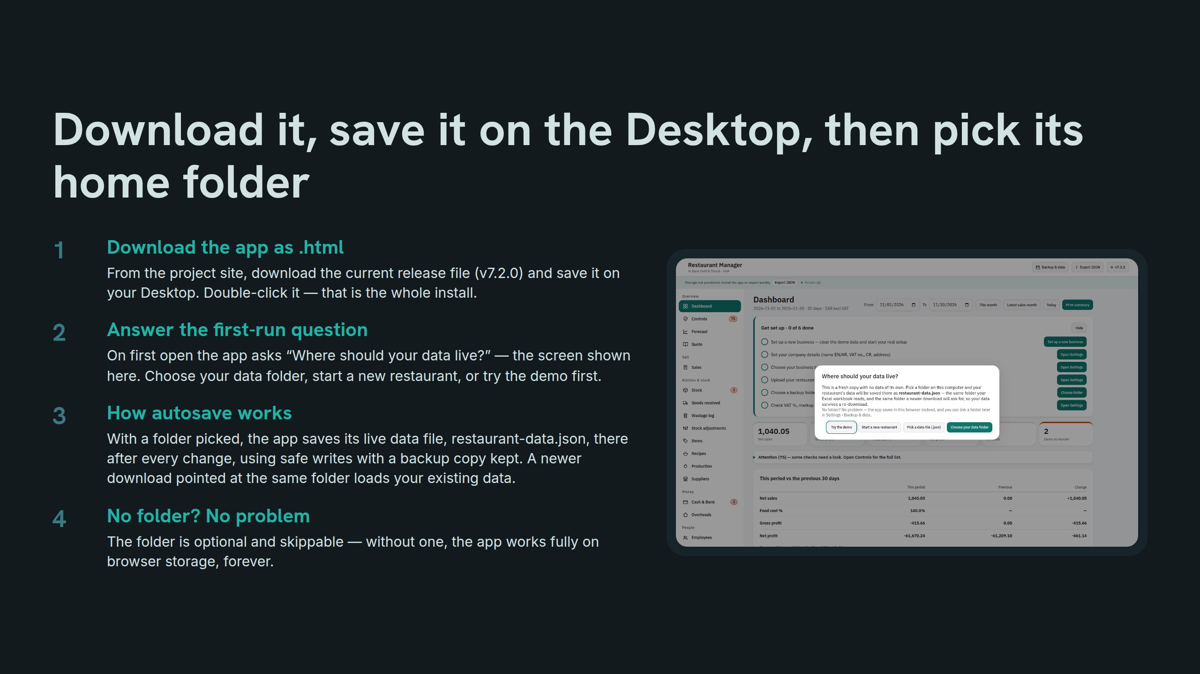
Notes:
Download it, save it on the Desktop, then pick its home folder

Slide 5
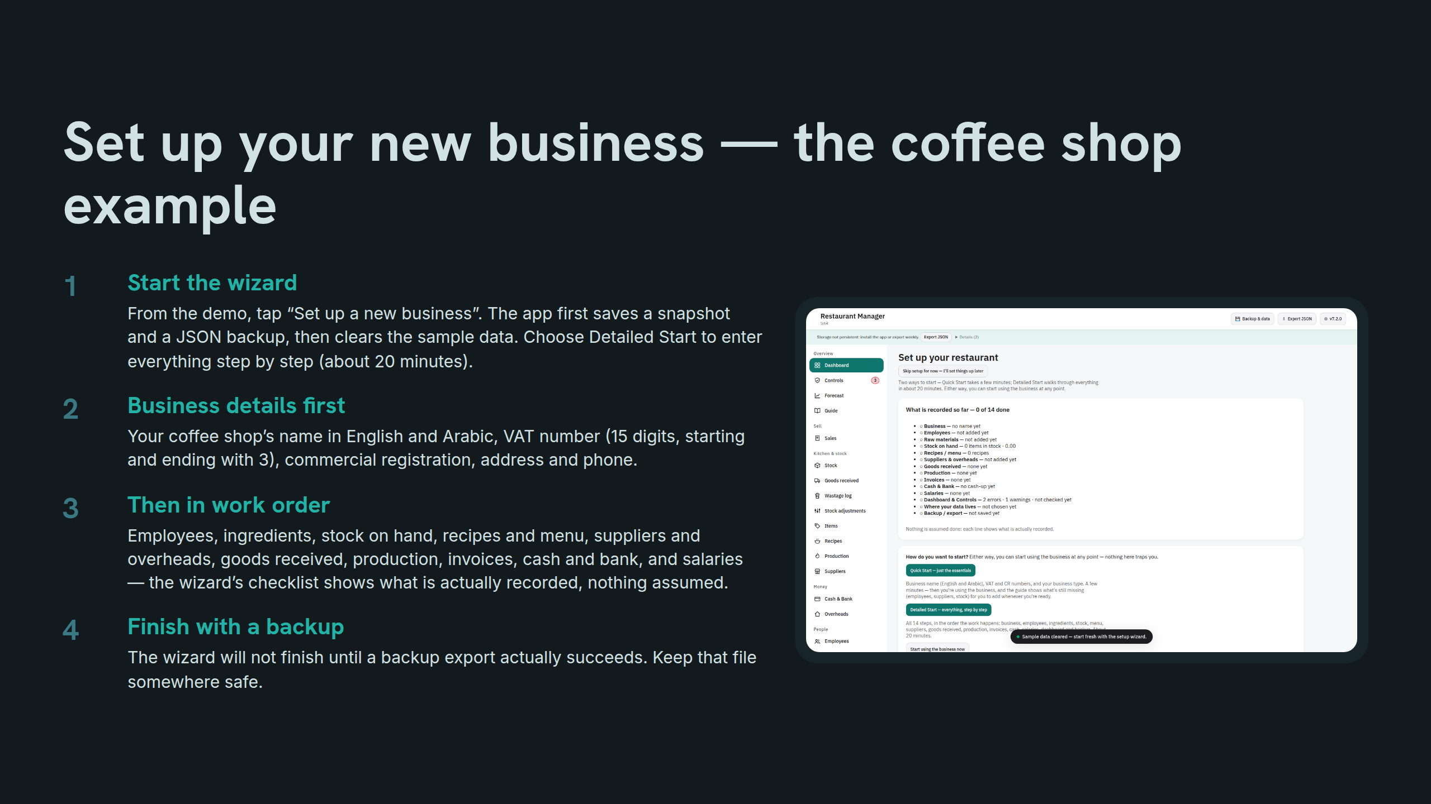
Notes:
Set up your new business — the coffee shop example

Slide 6
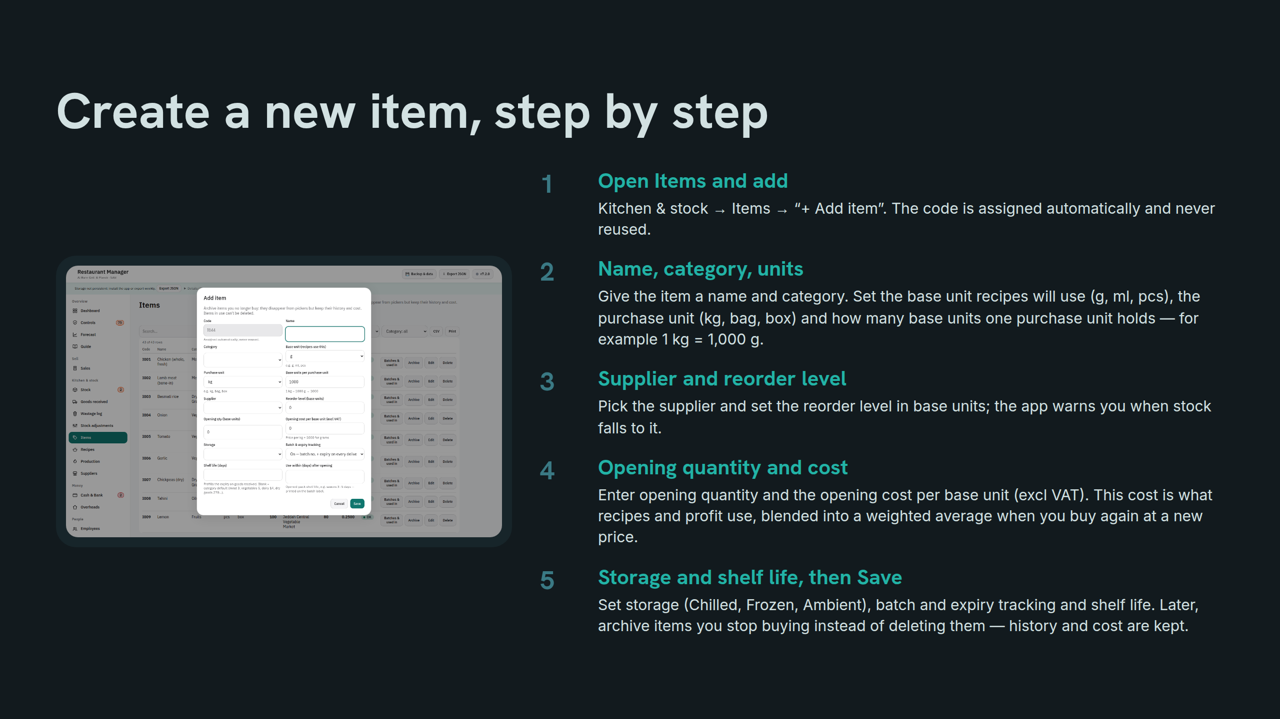
Notes:
Create a new item, step by step

Slide 7
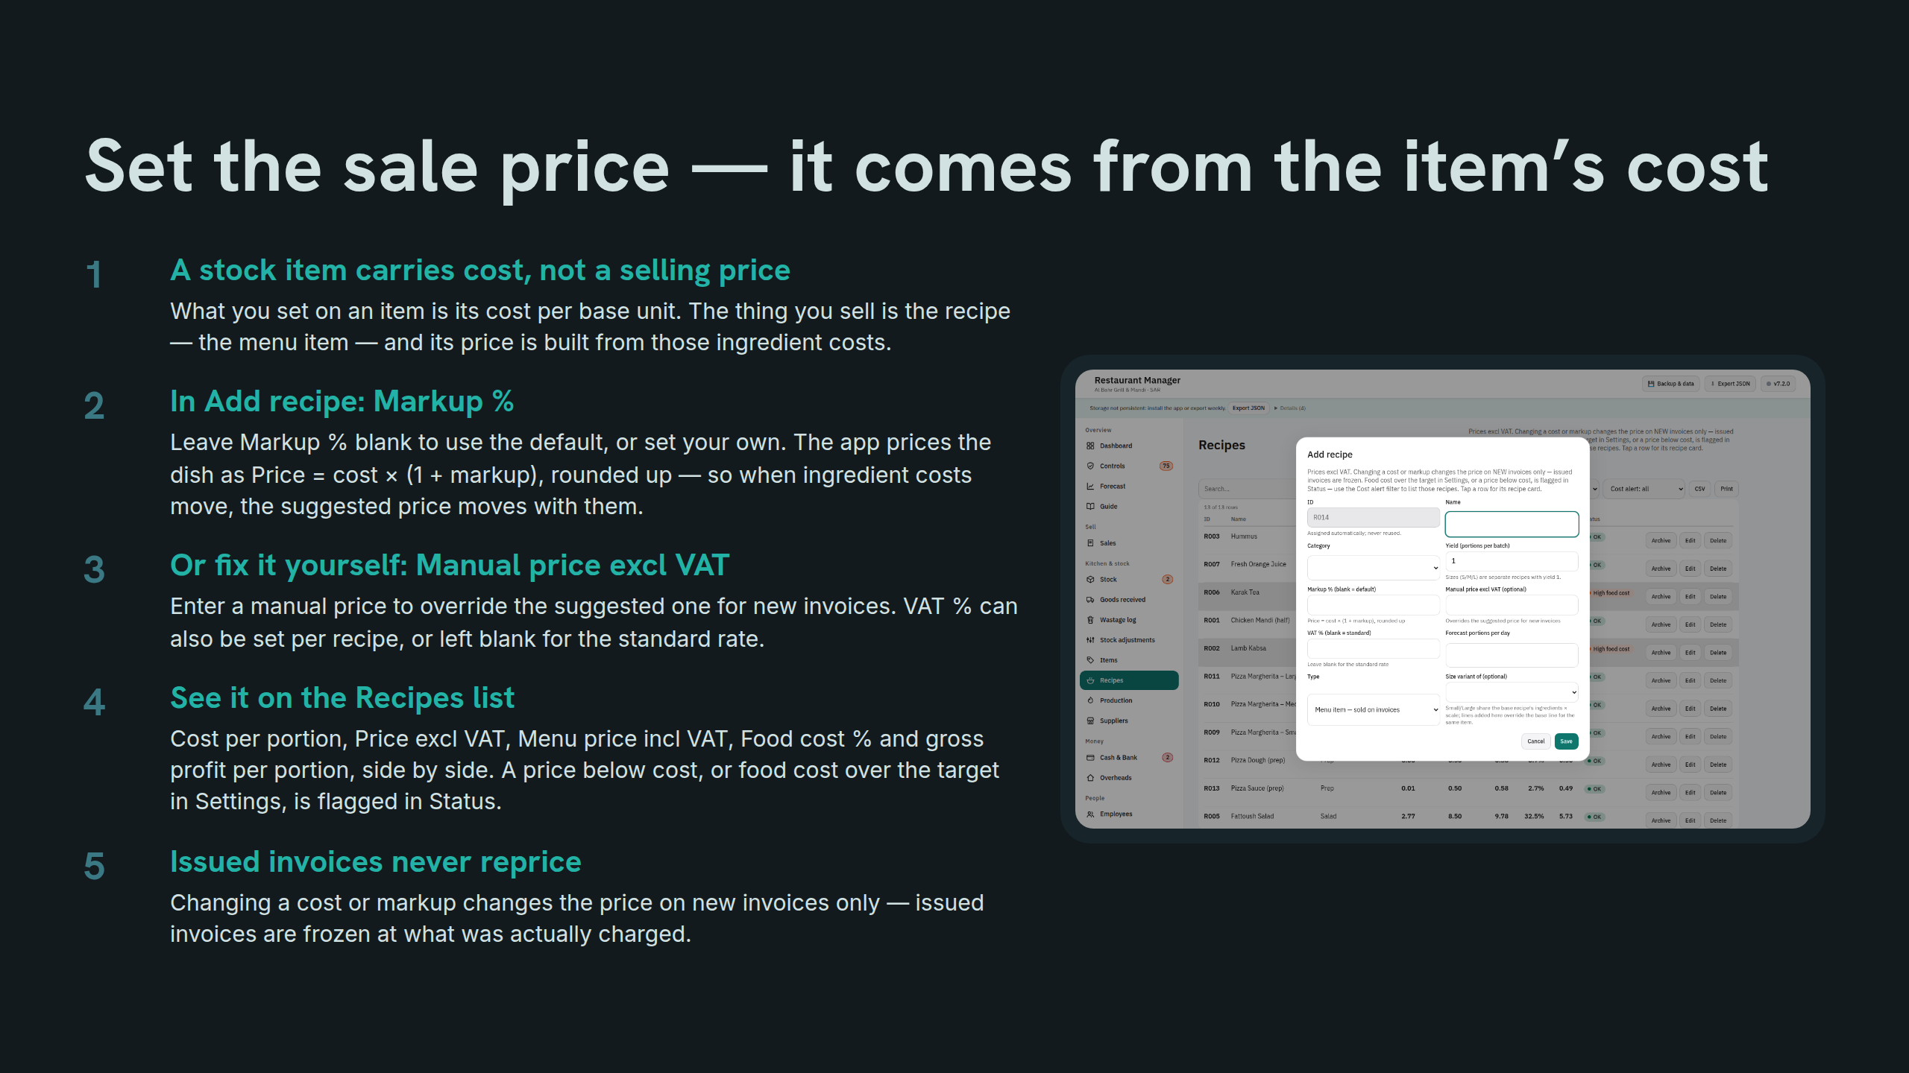
Notes:
Set the sale price — it comes from the item’s cost

Slide 8
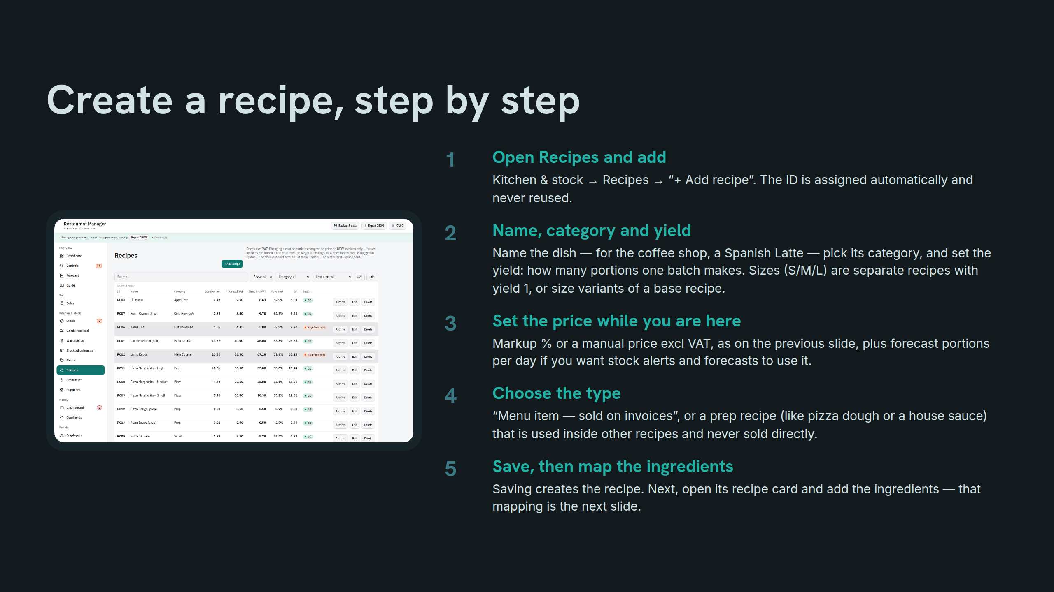
Notes:
Create a recipe, step by step

Slide 9
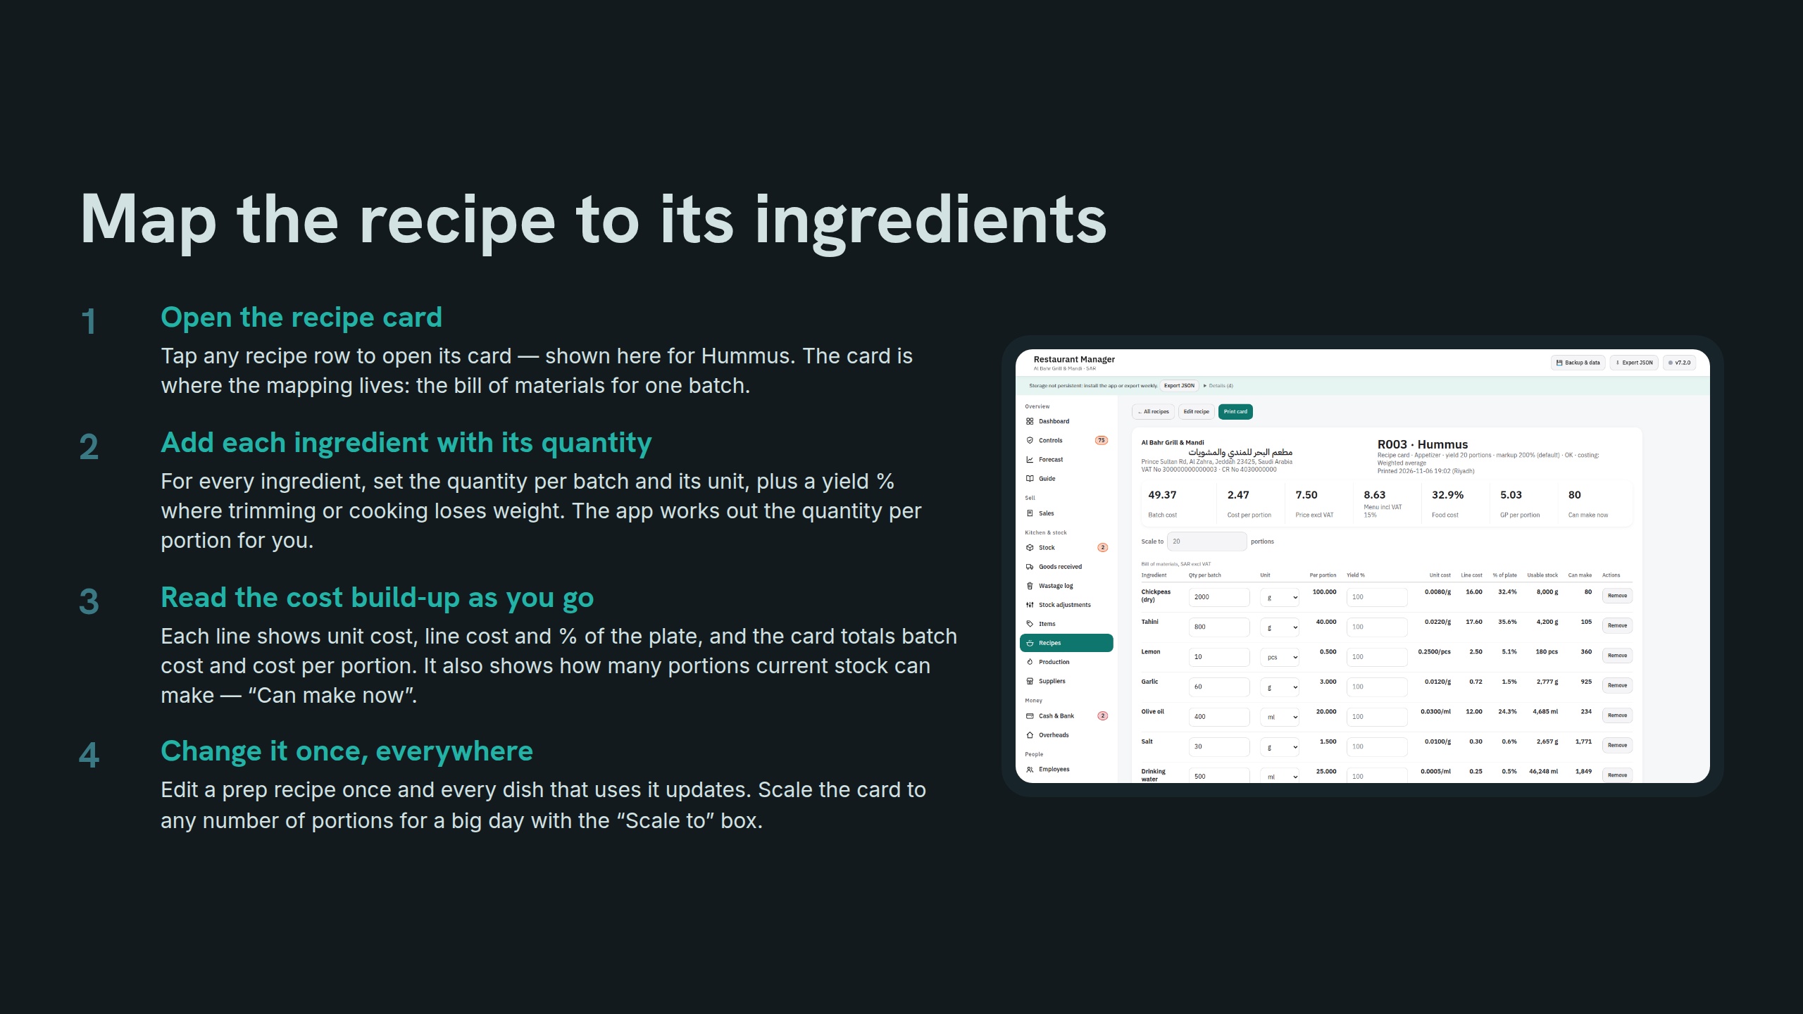
Notes:
Map the recipe to its ingredients

Slide 10
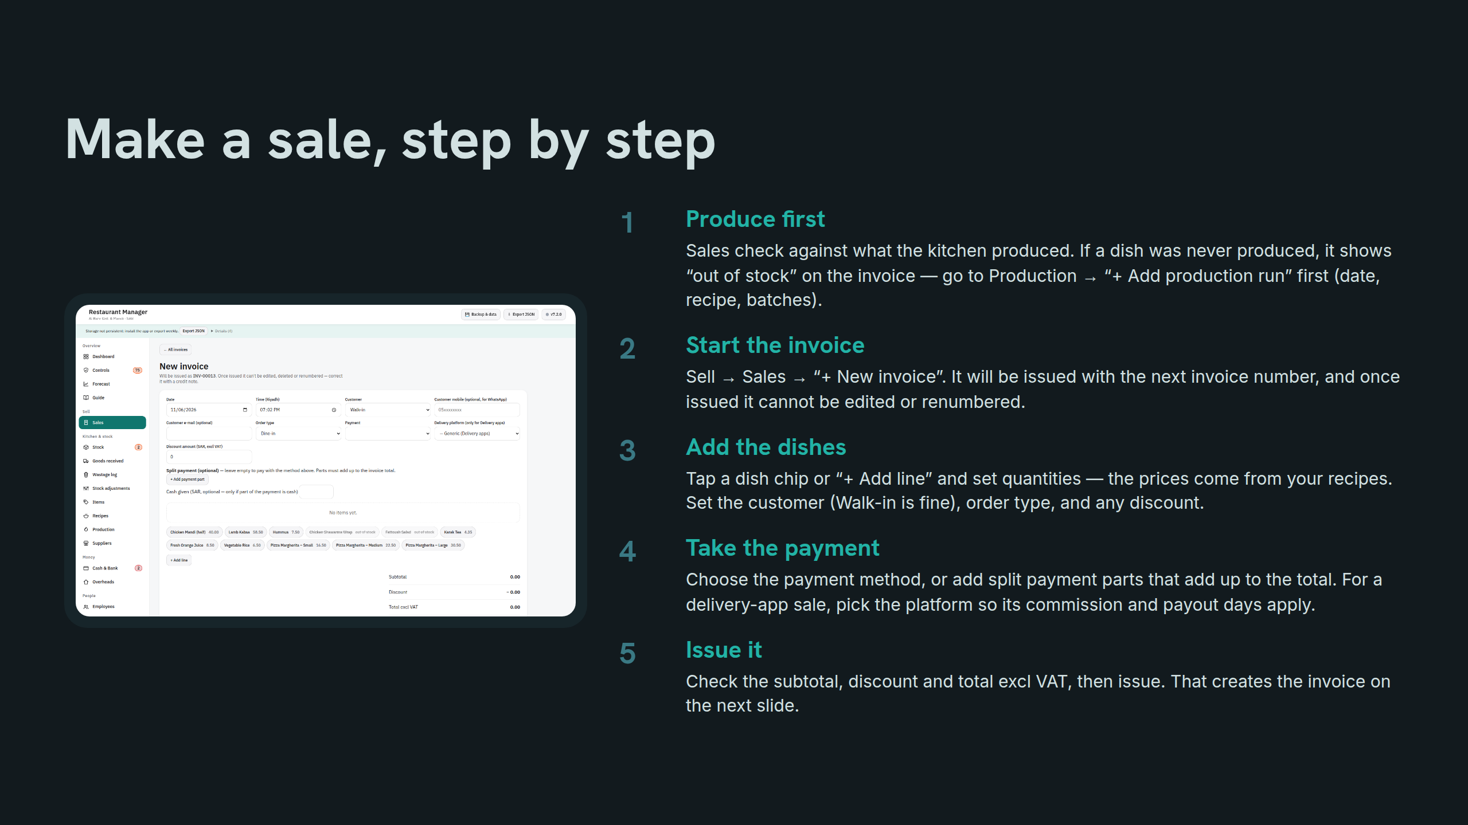
Notes:
Make a sale, step by step

Slide 11
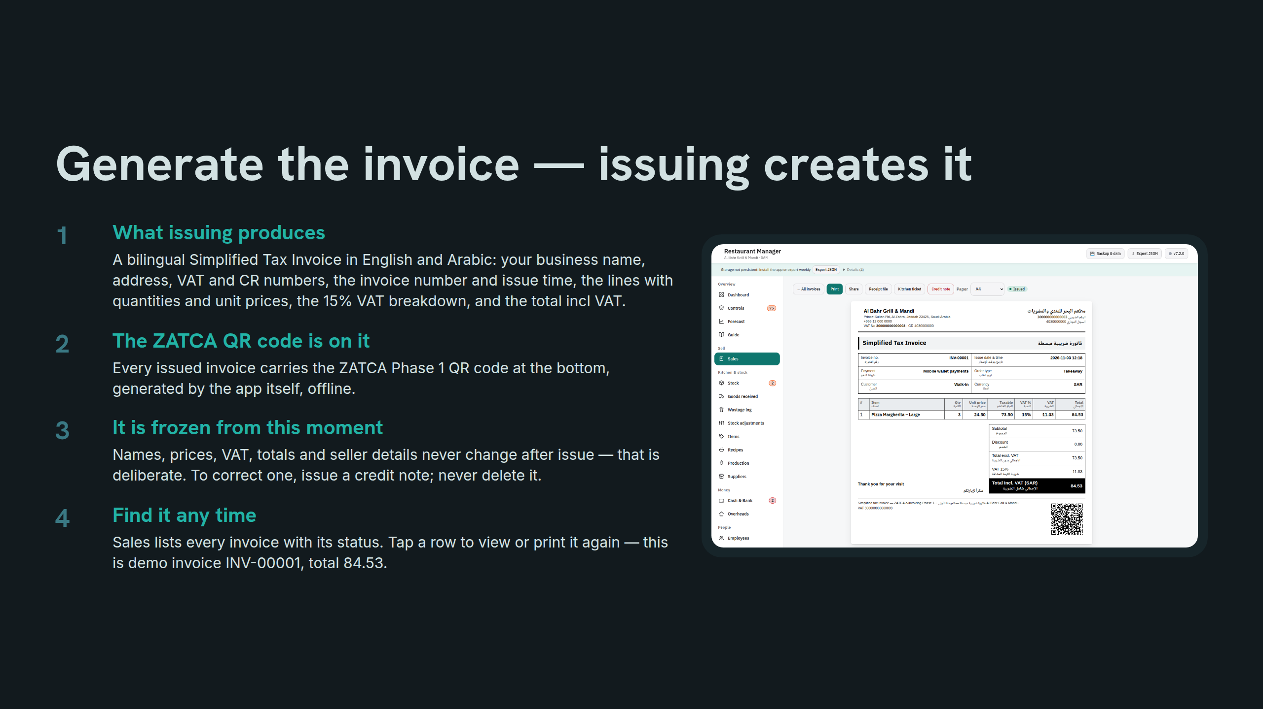
Notes:
Generate the invoice — issuing creates it

Slide 12
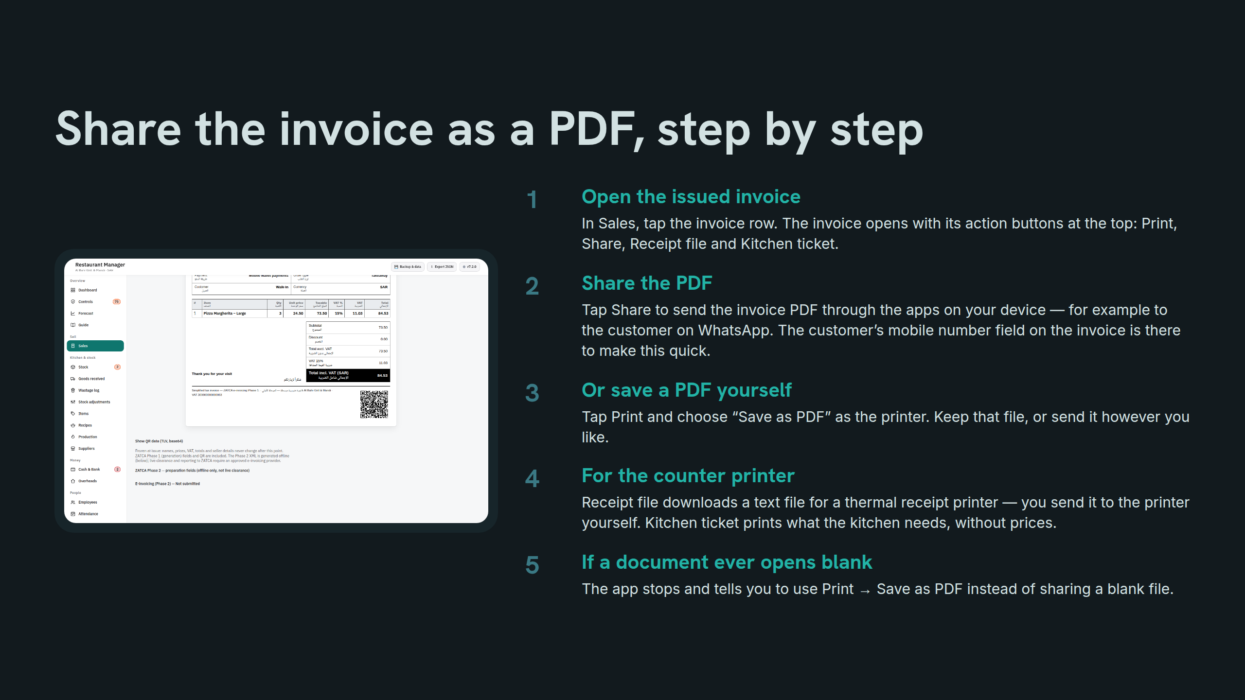
Notes:
Share the invoice as a PDF, step by step

Slide 13
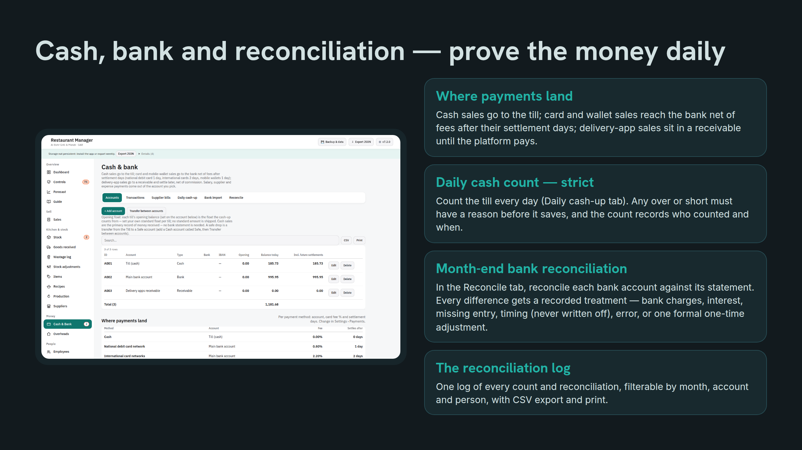
Notes:
Cash, bank and reconciliation — prove the money daily

Slide 14
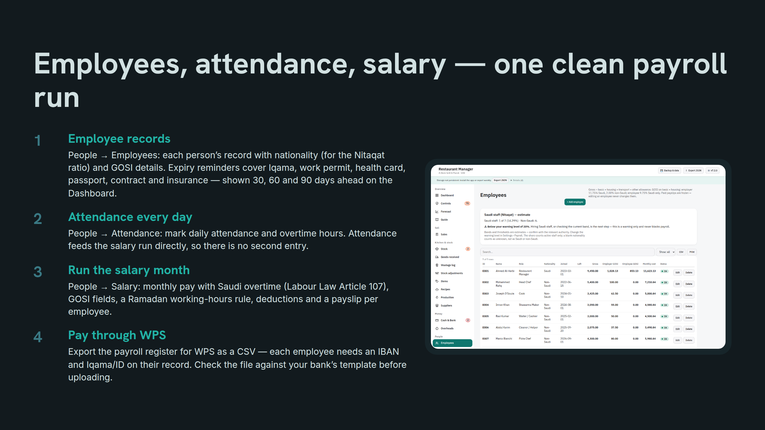
Notes:
Employees, attendance, salary — one clean payroll run

Slide 15
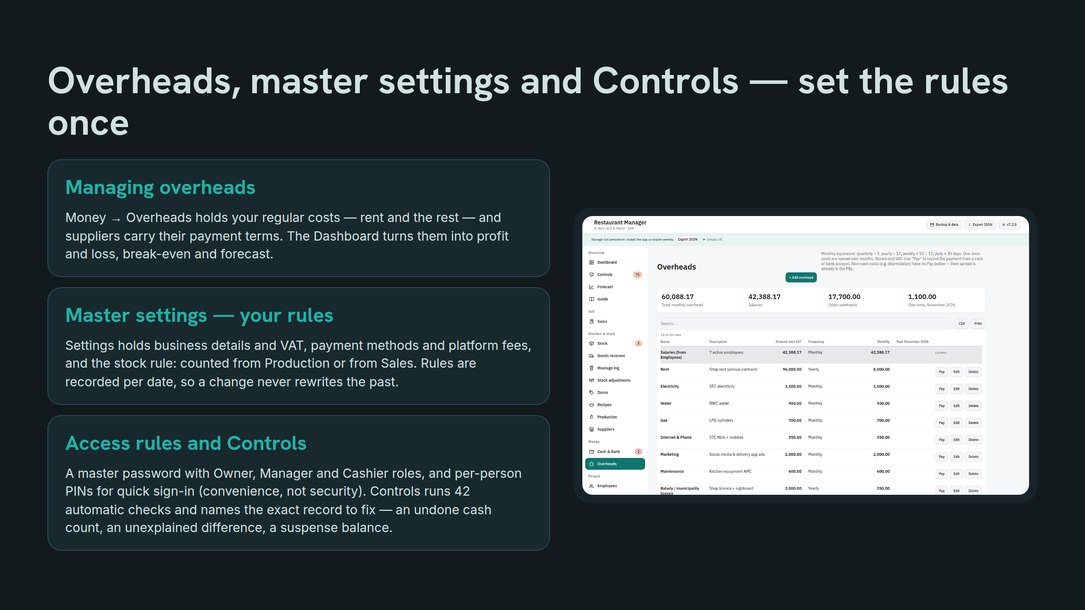
Notes:
Overheads, master settings and Controls — set the rules once

Slide 16
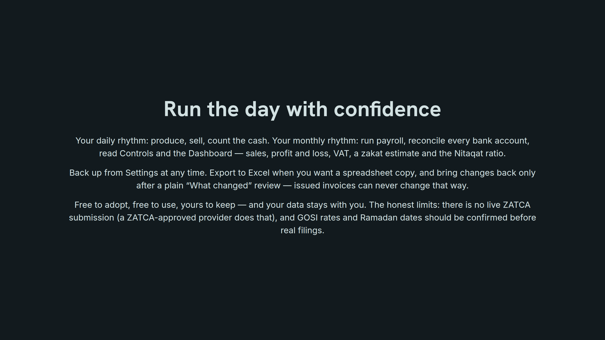
Notes:
Run the day with confidence

